Slide 1

BASKETBALL FREE THROWS ANALYSIS

Slide 2
Free throw analysis
You have been supplied data for two more additional in-game statistics:
  Free Throws
  Free Throw Attempts
You need to create three plots that portray the following insights:
  Free Throw Attempts per game
  Accuracy of Free Throws
  Player playing style (2 vs 3 points preference) excluding Free Throws*
  *Each Free Throw is worth 1 point
The data has been supplied in the form of vectors. You will have to create the two matrices before you proceed with the analysis

Slide 3
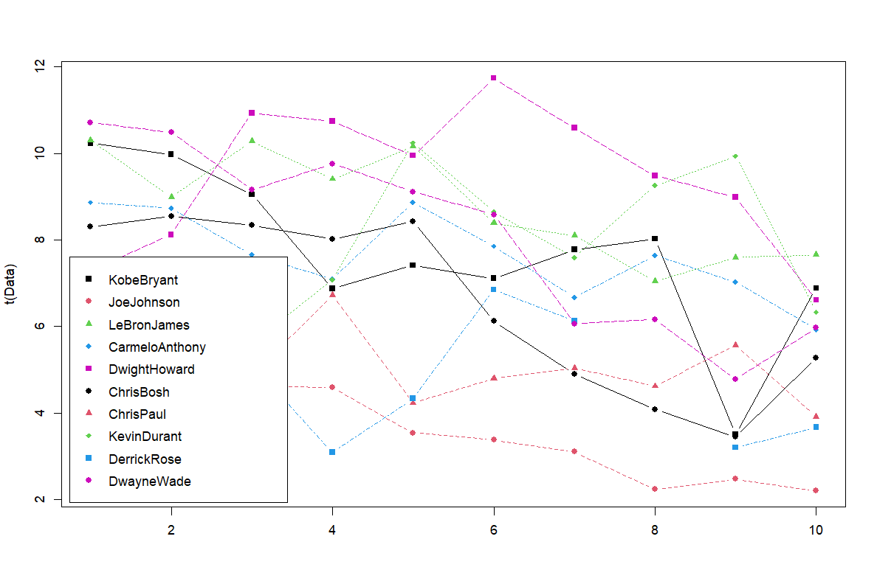
Free Throw Attempts per game

Slide 4
Insights: FT per game
The data revealed that the number of free throw attempts varied significantly between players and games. This variance may be influenced by the style of play, aggressiveness in driving to the basket, and drawing fouls.
Players who often engage in close contact play or drive towards the basket tend to earn more free throw opportunities, indicating their aggressive play style.

Slide 5
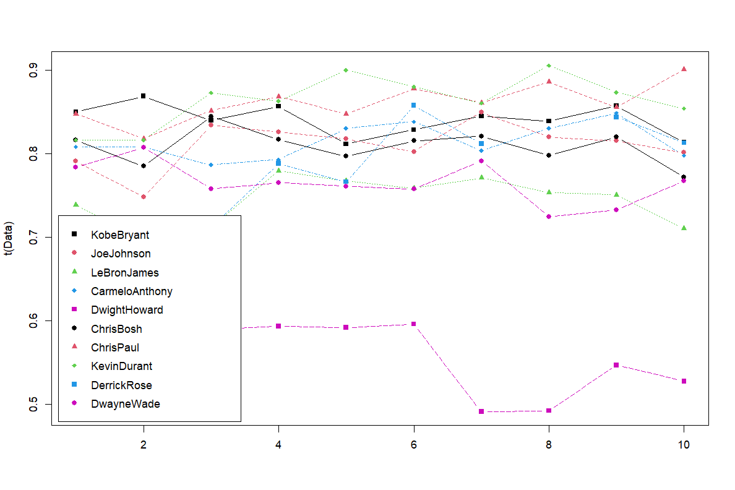
Accuracy of Free Throws

Slide 6
Insights : Free throw %
The accuracy of free throws showed a direct impact on a team’s scoring potential. Players with higher free throw accuracy significantly contribute to the scoreboard, especially during crucial moments.
Improving free throw accuracy could elevate a player’s overall scoring contribution, particularly in high-pressure situations such as the final minutes of a game

Slide 7
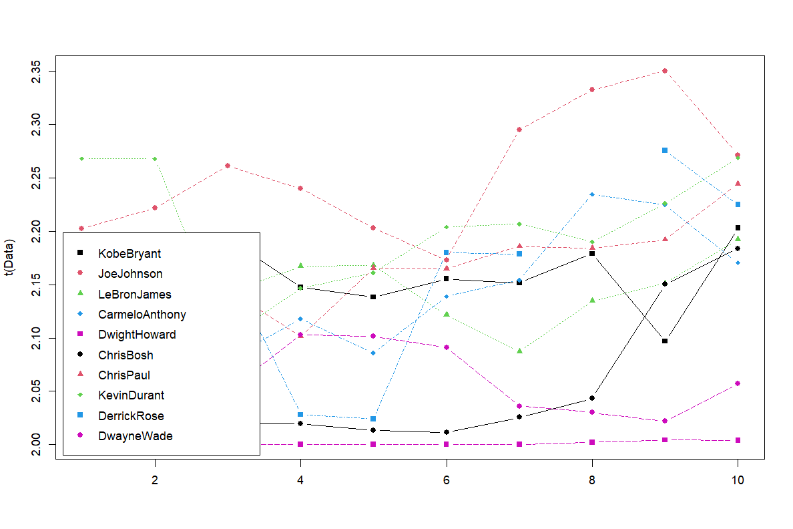
Player playing style

Slide 8
Insights and key findings
When analyzing player tendencies (excluding free throws), some players heavily favor 2-point shots, particularly those who prefer closer shots or play near the paint.
Conversely, players with a strong preference for 3-point shooting tend to focus on perimeter play, offering different strategic benefits such as floor spacing and stretching the defense.

Slide 9

Conclusions
Free throws are an essential yet often overlooked aspect of basketball that can be the difference between winning and losing close games.
Players with high free throw attempts often reflect an aggressive and physical play style, which, combined with accuracy, can turn fouls into consistent points.
Developing both free throw accuracy and a balanced playing style between 2-point and 3-point attempts could maximize scoring efficiency and improve overall team success.
Notes:
This analysis suggests that teams should focus not only on shot selection but also on enhancing players' ability to convert free throws consistently, as these "free points" are pivotal in game outcomes.

